Slide 1

Bank Marketing Strategy
<Improve Targeting Efficiency>
<2023.2.10>

Slide 2
Agenda
Executive Summary
Problem Statement
Approach
Model Selection
Model Tuning & Validation
Metric Evaluation & Result

Slide 3
Executive Summary
Clean and preprocess the dataset for machine learning
Select machine learning models to trial
Build pipelines to deal with scale of the features & class imbalance
Feature reduction & hyperparameter tuning
Result evaluation

Slide 4
Problem Statement
This project aims to fix the problem that there are too many potential clients associate with a Portuguese banking institution. The bank marketing campaigns are primarily based on phone calls. However, there are too many potential clients, and it is impossible to call all of them. Hence, some machine learning techniques are needed to classify the customers and predict if they are going to subscribe the term deposit or not. By implementing ML models, we are able to limit the number of ‘potential clients’ to an acceptable number that make sure the marketing strategies can be carried on.

Slide 5
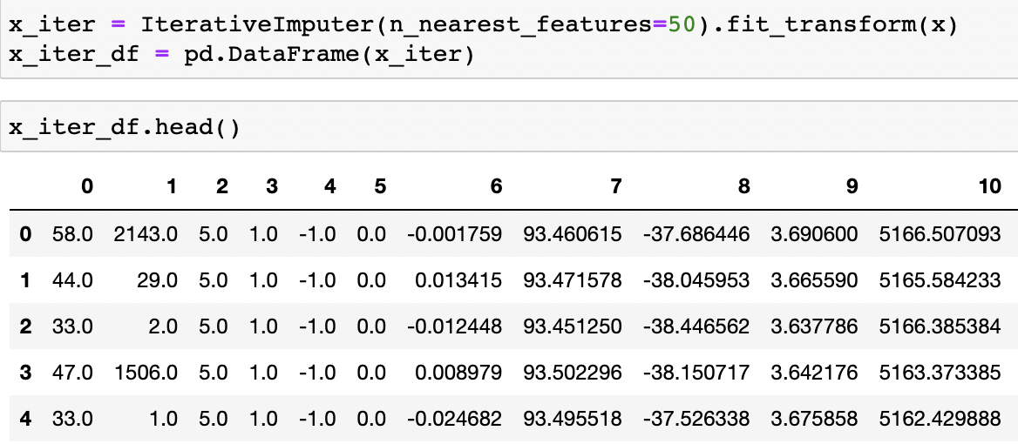
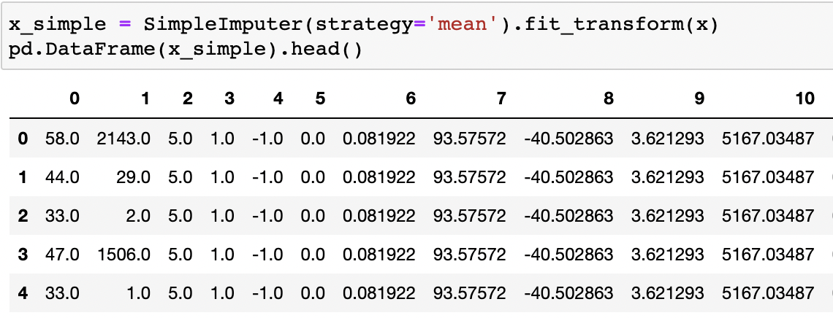
Approach
Data Loaded & Cleaning & Preprocessing
Data Imputation
Simple imputer
Iterative imputer
KNN imputer

Slide 6
Approach
Machine Learning Algorithms
Feature engineering & Hyperparameter tuning
Result explanation

Slide 7
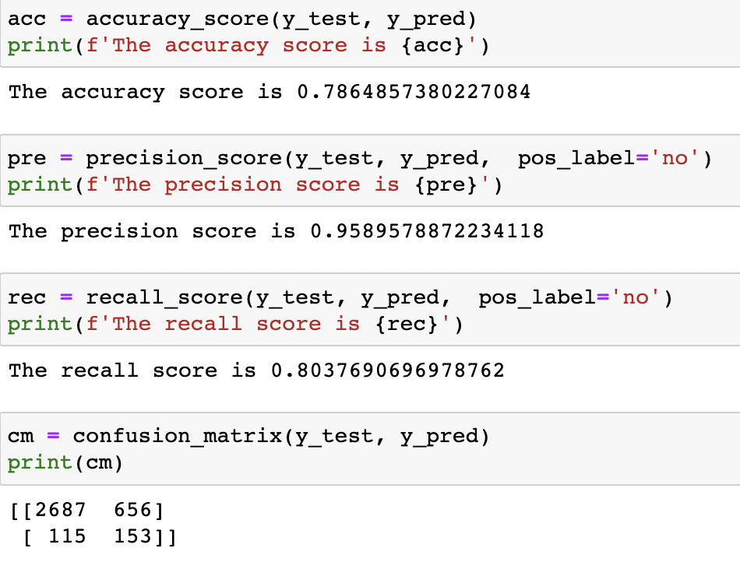
Logistic Regression
Most widely used binary classification linear technique
L1 Penalized
Very good precision of 96%

Slide 8
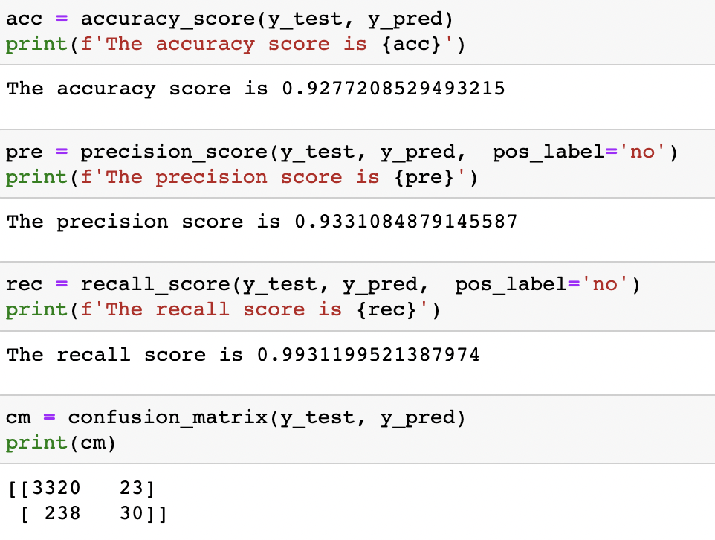
Logistic Regression
RFE instead of L1
Another way of feature reduction
Very good in all of the metrics

Slide 9
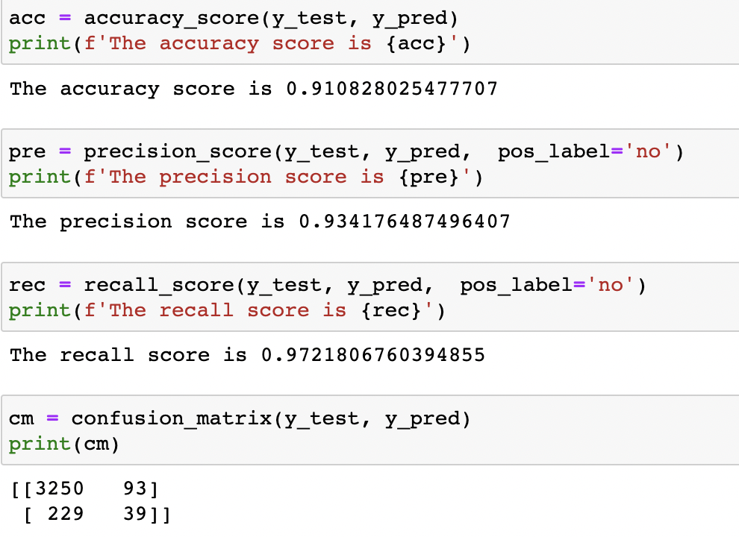
KNN
Make decision based on the nearest neighbors given a certain distance metric
Especially good in precision of 93.4%

Slide 10
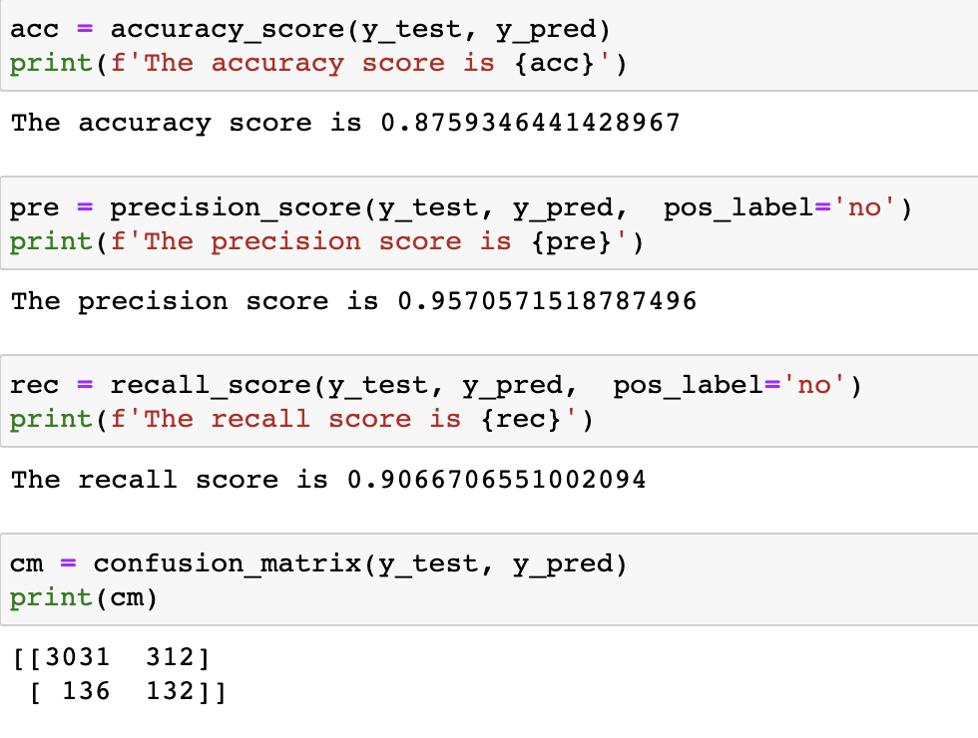
Random Forest
Bagging Tree
Ensembled Method
Improve learning once
Low accuracy but high precision

Slide 11
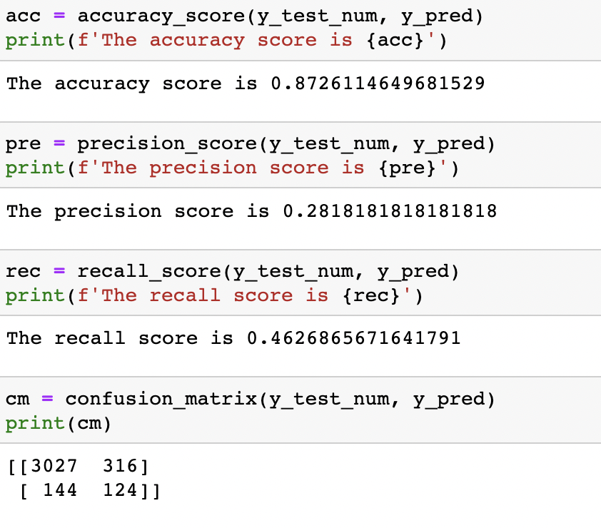
XGBoost
Ensemble Method
Boosting Method
Improve learning sequentially
Not an ideal model for this case

Slide 12
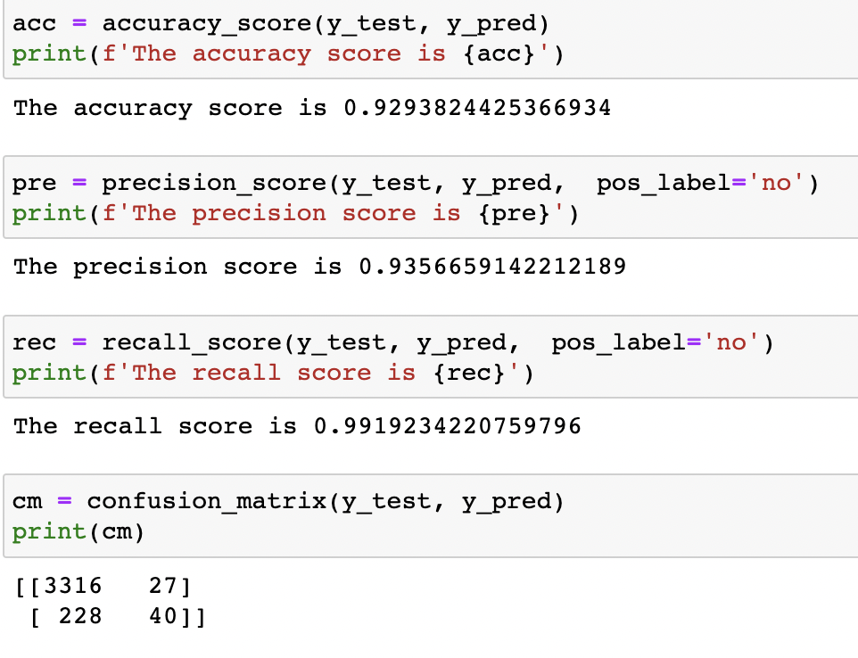
SVM
Kernel based method
RBF means KNN
Only use influential data points
Long training time, require more computation resource

Slide 13
Summary
According to the models above and the metrics we used, logistic regression with recursive feature elimination and support vector machine with RBF kernel had the greatest accuracy while considerable precision/recall score. When converting these ML metrics into business metrics, this filtering model that select potential clients could significantly improve our targeting efficiency. Reducing the number of targeted clients while still convincing a lot of them to subscribe, the targeting efficiency could be boosted.

Slide 14
Results
Optimal Models: Logistic Regression (RFE Based), KNN, SVM
Precision-weighted: Logistic Regression (l1-penalized), Random Forest
Machine Learning is just AI model that help people make decision. Not even one model is ‘correct’, but some of them are useful.

Slide 15
Thank You

